Slide 1

Customer Profiles
For
Regional Bank
By Aishani Sood

Slide 2
The Goal
To create customer profiles based on affinity to technology for future digital ventures
Notes:
Regional bank has rolled out a new mobile app and has been tracking customer logins from 0 to 9 months. It plans to increase their digital application’s (which is Regional GO application) features and would like to know which customers would be early adopters. Our goal is to create customer profiles that help Regional Bank get a sense of customers who have affinity to technology and readily adopt new applications.

Slide 3

What is Customer Profile ?
Fictional person that represents a group of customers with similar demographics, behaviors, and attitudes. A group of relevant and meaningful common factors based on customer data.
Why do we need personas
Helps to design and develop feature keeping user and their needs in mind.
Understanding primary customers’ needs and expectations
Target marketing to the right customer

Slide 4
Approach
Bins
5 Bins
20% Cumulative contribution to total logins
Clusters
5 Clusters
Closeness of customers to the attributes of centroids
Notes:
I grouped customers using 2 methods and compared results to find the best model to create customer profiles. binning technique and clustering technique were used.
Bins were created with total login contribution while clustering uses multiple variables to create clusters. Clustering allowed me to group customers and provided a great variation for multiple attributes.

Slide 5





Clusters
Cluster 4
2%
Cluster 5
27%
Cluster 3
14%
Cluster 2
41%
Cluster 1
16%
Notes:
Regional Bank customer base was grouped into 5 clusters with cluster 2 being the biggest cluster consisting of 41% of the sample population and cluster 4 being the smallest representing 2% of the sample population.

Slide 6
Profile Content
Demographic
Behavior
Geographic
Transaction Patterns

Slide 7
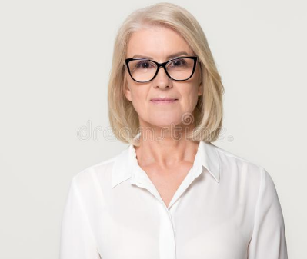
Edna
(Cluster 1: 16%)
Affinity to Technology : Low
Age : 66
State: Arkansas
Spending: High
Saving: High
Work Phone Not Provided

Slide 8

Kevin
(Cluster 2: 41%)
Affinity to Technology : Low
Age : 27
State: Arkansas
Spending: Low
Saving: Low
Work Phone Not Provided

Slide 9

Sherri
(Cluster 3: 14%)
Affinity to Technology : Medium
Age : 31
State: Arkansas
Spending: Medium
Saving: Medium
Work Phone Not Provided

Slide 10
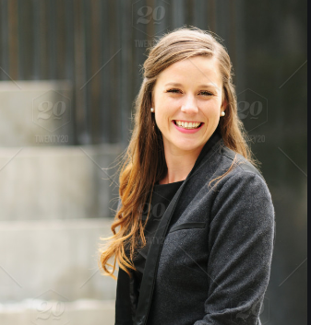
Tina Technology
(Cluster 4: 2%)
Affinity to Technology : High
Age : 32
State: Oklahoma
Spending: Medium
Saving: High
Work Phone Not Provided

Slide 11
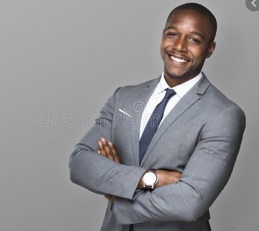
James
(Cluster 5: 27%)
Affinity to Technology : Very Low
Age : 47
State: Arkansas
Spending: Low
Saving: Low
Work Phone Provided

Slide 12
Conclusion
Understanding customer base becomes easy
Designing new app or feature with certain customers in mind such as Kevin, James or Sherri can help increase interaction with the new apps or features.
Targeting Tina to pilot new apps and gathering valuable feedback can help improve.
Tina can also be used as voice of new features or technology rolled out by the bank. This can help other customers with faster uptake.
Negative feedback travels faster than positive feedback so before rolling out new technology Kevin, James and Edna can be given early information about the change to help them onboard for the change.

Slide 13

Thank You
Questions?

